Slide 1
Another way to apply a CNOT gate to non-adjacent qubits in a multi-qubit system is to use permutation operations to reorder the qubits in the state vector. This approach can be simpler and more efficient than using SWAP gate insertion.
In this approach, we first permute the indices of the state vector so that the control and target qubits are next to each other. Then we apply the CNOT gate directly using its matrix representation. Finally, we apply the inverse permutation to the resulting state vector to restore the original order of the qubits.
Here’s an example of how this can be done in code for a three-qubit system where the control qubit is qubit 0 and the target qubit is qubit 2:
psi = np.kron(np.array([0, 1]), np.kron(np.array([1, 0]), np.array([1, 0]))) # Define the CNOT gate CNOT = np.array([[1, 0, 0, 0], [0, 1, 0, 0], [0, 0, 0, 1], [0, 0, 1, 0]])

Slide 2
# Define the permutation that moves qubit 2 to position 1 """ 说白了就是映射坐标轴 x = np.arange(12).reshape((2, 3, 2)) x.transpose(1, 2, 0)，其实就是将x第二维度挪到第一维上，第三维移到第二维上，原本的第一维移动到第三维上，最后的shape为：(3，2，2) """ perm = [0, 2, 1] I = np.eye(2) # Apply the permutation to a state vector psi_perm = np.reshape(psi, (2, 2, 2)) psi_perm = np.transpose(psi_perm, perm) psi_perm = np.reshape(psi_perm, (8,)) # Apply the CNOT gate to the permuted state vector psi_perm = np.kron(CNOT, I) @ psi_perm # Apply the inverse permutation to the resulting state vector psi_final = np.reshape(psi_perm, (2, 2, 2)) psi_final = np.transpose(psi_final, np.argsort(perm)) psi_final = np.reshape(psi_final, (8,))

Slide 3
This code defines the CNOT gate as a matrix and applies it to a state vector representing three qubits. The state vector is first reshaped into a rank-3 tensor and then transposed using the np.transpose() function to permute its indices. The CNOT gate is then applied to the permuted state vector using matrix multiplication. Finally, the inverse permutation is applied to restore the original order of the qubits. The mathematical principle behind this approach is that we can use tensor manipulations such as reshaping and transposing to reorder the indices of a state vector representing multiple qubits. By permuting the indices of the state vector in this way, we can move non-adjacent qubits next to each other and apply two-qubit gates directly using their matrix representations.

Slide 4

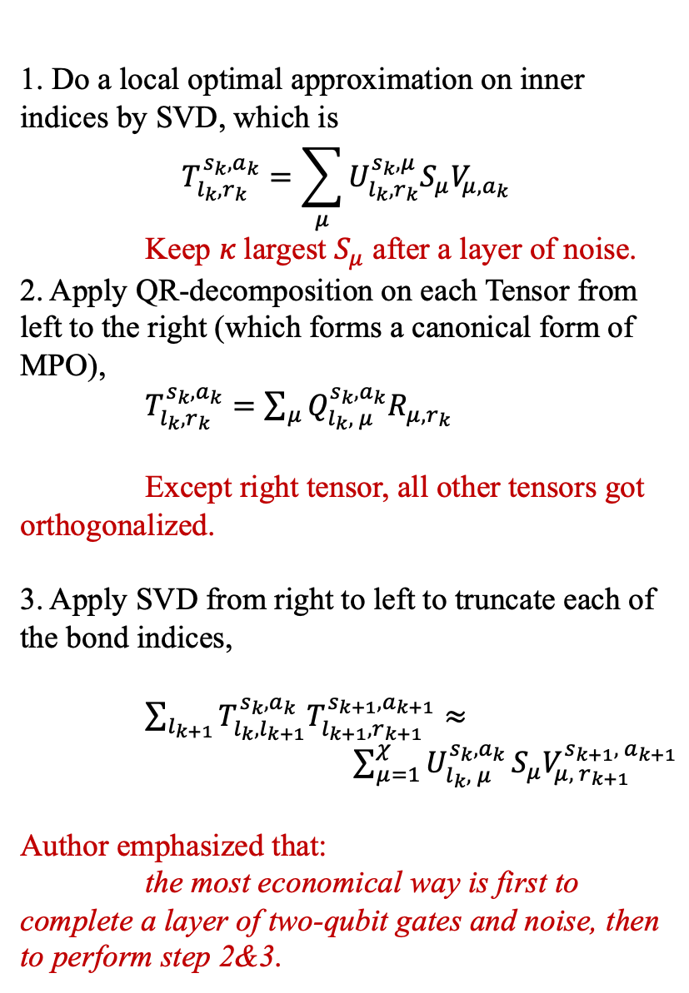




1. Do a local optimal approximation on inner indices by SVD, which is
$$T_{l_{k}, r_{k}}^{s_{k}, a_{k}}=\sum_{μ}{U_{l_{k}, r_{k}}^{s_{k}, μ}S_{μ}V_{μ, a_{k}}}$$
Keep $κ$largest $S_{μ}$ after a layer of noise.
2. Apply QR-decomposition on each Tensor from left to the right (which forms a canonical form of MPO),
$T_{l_{k}, r_{k}}^{s_{k}, a_{k}}=\sum_{μ}{Q_{l_{k}, μ}^{s_{k}, a_{k}}R_{μ, r_{k}}}$
Except right tensor, all other tensors got orthogonalized.
3. Apply SVD from right to left to truncate each of the bond indices,
$\sum_{l_{k+1}}{T_{l_{k}, l_{k+1}}^{s_{k}, a_{k}}T_{l_{k+1}, r_{k+1}}^{s_{k+1}, a_{k+1}}}≈ \sum_{μ=1}^{χ}{U_{l_{k}, μ}^{s_{k}, a_{k}}}S_{μ}V_{μ, r_{k+1}}^{s_{k+1}, { a}_{k+1}}$
Author emphasized that:
the most economical way is first to complete a layer of two-qubit gates and noise, then to perform step 2&3.
Legend:
Single-qubit Gate
Rank-2 Tensor
Two-qubit Gate
Rank-4 Tensor
$$s_{k}$$
$$r_{k}$$
$$l_{k}$$
Rank-4 Tensor: $T_{l_{k}, r_{k}}^{s_{k}, a_{k}}$
$$a_{k}$$
Noise Channel
Quantum Entanglement

Slide 5
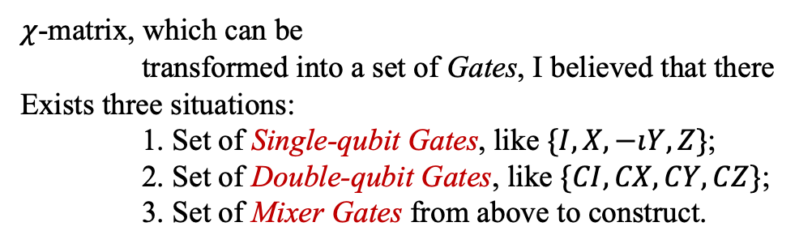
$χ$-matrix, which can be
transformed into a set of Gates, I believed that there
Exists three situations:
1. Set of Single-qubit Gates, like $\{I, X, −ıY, Z\}$;
2. Set of Double-qubit Gates, like $\{CI, CX, CY, CZ\}$;
3. Set of Mixer Gates from above to construct.

Slide 6




physics
physics_0
physics_1
inner
inner_0
inner_1
physics_1
$$s_{k}$$
$$r_{k}$$
bond_0_1
$$l_{k}$$
bond_1_2
$$a_{k}$$
I_1

